Slide 1
Cloud computing fundamentals

Slide 2

requirement
I want to setup a global business, across the globe.

Slide 3

My issue
I don’t have budget(limited money)

Slide 4


Slide 5

Do you think it’s one person problem
No, multiple people are facing same issue

Slide 6
Should they stop?
No, Continue your business with one country

Slide 7
Problem if I am running business with one place
Suppose, I am driving my business . Lets say India for example. Now multiple people are facing latency issue

Slide 8
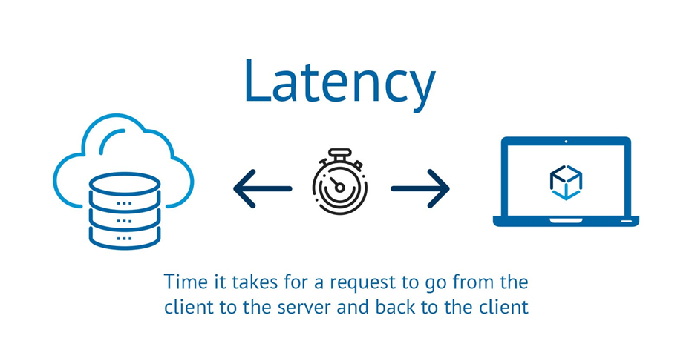
What is latency?

Slide 9

Are you joking?
Is it really possible to have latency?

Slide 10
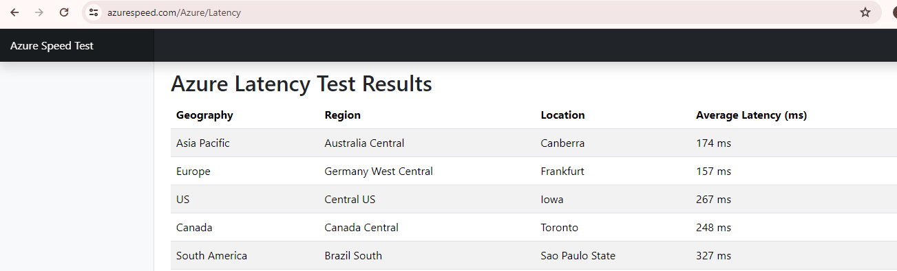
Latency calculator azure
Azure: https://www.azurespeed.com/Azure/Latency

Slide 11
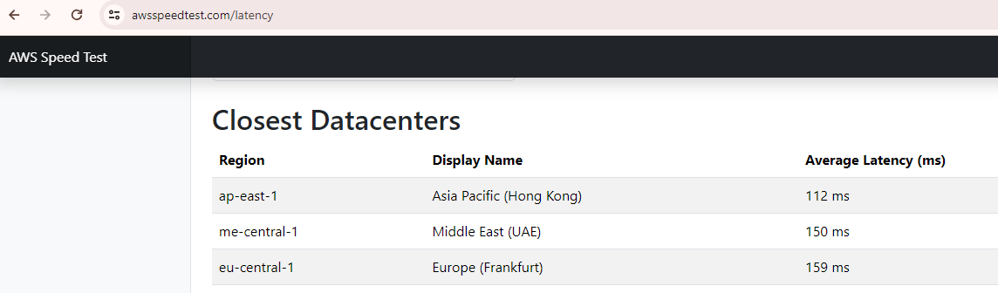
Latency calculator aws
Link: https://awsspeedtest.com/latency

Slide 12
How cloud provider solved this problem?
They invested huge amount and created large infrastructure, so now everyone can have business in major of the countries without latency.

Slide 13
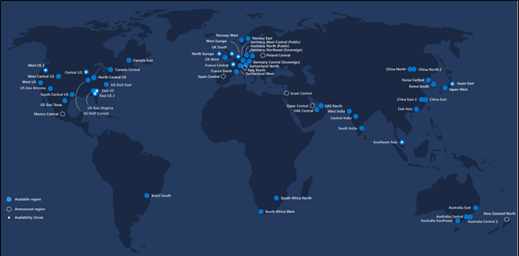

Slide 14
Business model of cloud provider?
Renting the servers on pay per use basis.

Slide 15
Cloud computing
Renting infrastructure across the globe and providing compute, storage, networking and database solutions.

Slide 16
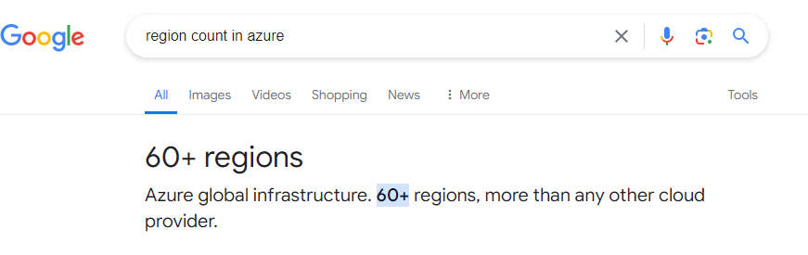
background
In the world we have approx. 195 countries, so many of them are not business oriented country, so cloud providers has created data center access multiple countries.

Slide 17
What is region?
It’s a physical location where server’s are physically installed. Referred as data centre
Note: We can select region while doing any activity.

Slide 18


Slide 19
What data centre consists?
Compute resource >> where we need memory and CPU
Storage resource
Networking resource
Database resource

Slide 20
Need of datacentre
Power, power backup(generator)
Monitoring zone
Physical security
Large area
If anything goes wrong, it may cause outage

Slide 21
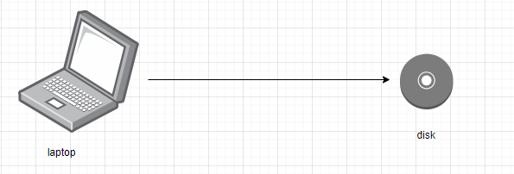
Case study: saving backup in disk drive

Slide 22
Unfortunate condition
My laptop was having some issue, so I formatted it, and I was thinking
That I will restore my things from my drive, but drive is having some virus.

Slide 23
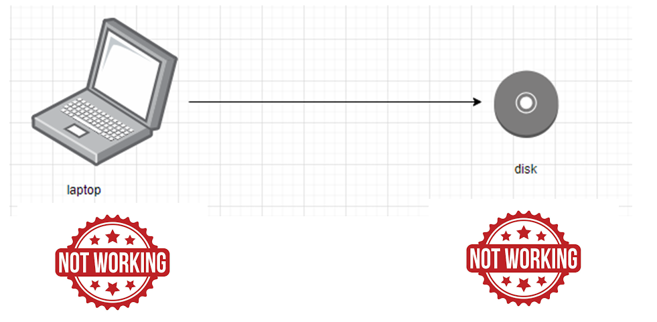
Case study: saving backup in disk drive

Slide 24

My condition now

Slide 25
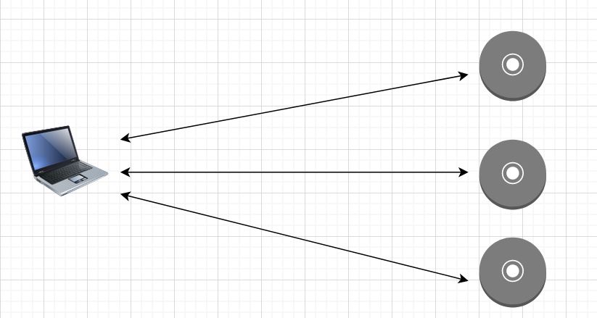
Saving data in 3 place

Slide 26
Saving data in 3 places
Storage cost= storage cost *3

Slide 27
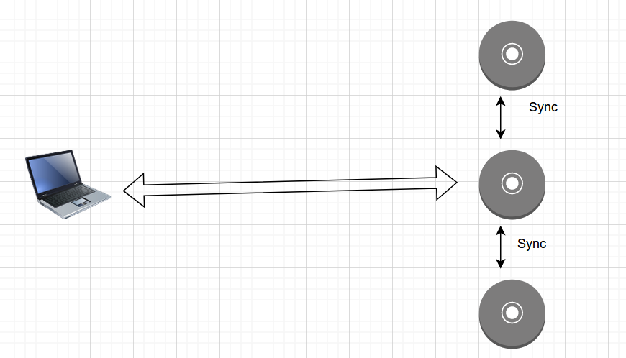
Cloud way to deal with this failure

Slide 28
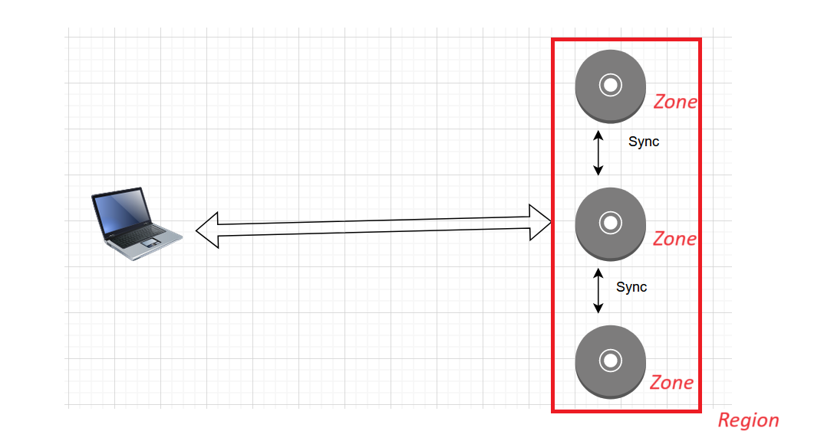
Now related the terminology

Slide 29
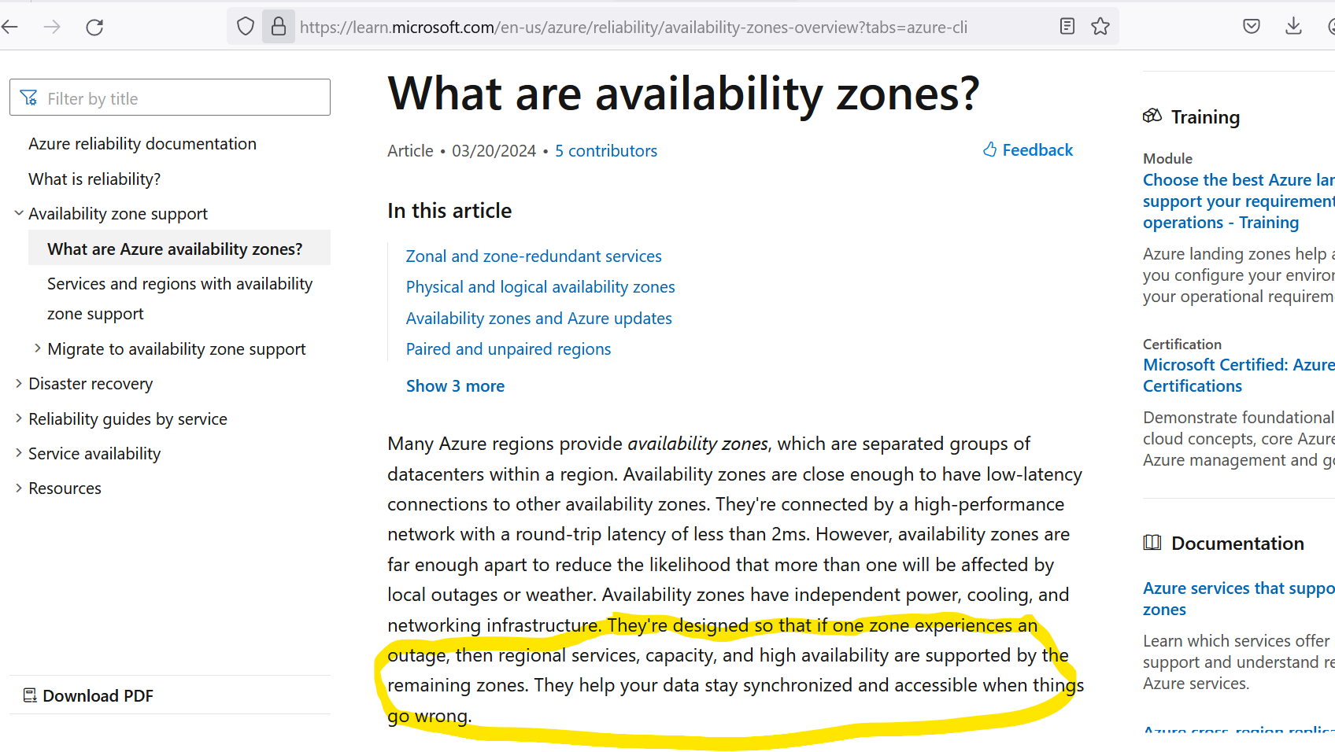
https://learn.microsoft.com/en-us/azure/reliability/availability-zones-overview?tabs=azure-cli

Slide 30
Types of Cloud
Private cloud
Public cloud
Community cloud
Hybrid cloud

Slide 31
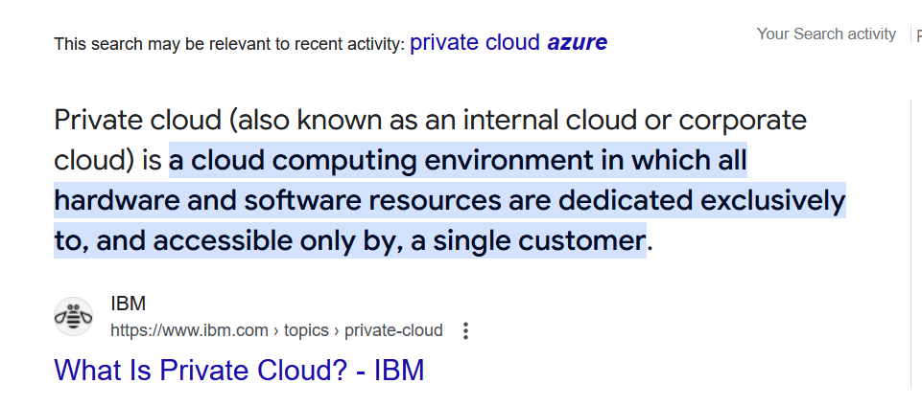
Private cloud

Slide 32
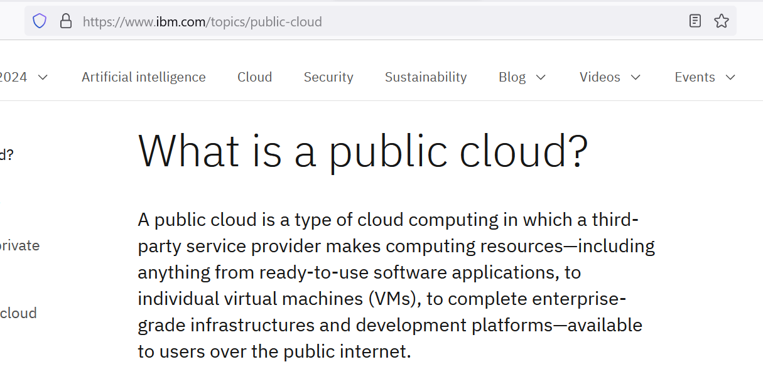
Public cloud

Slide 33
Community cloud
A community cloud is a cloud infrastructure in which multiple organizations share resources and services based on common requirements.
Example: Let say IBM(Support), TCS(Development), Accenture(data management) are working on project. Now all things would be shared within them

Slide 34
Hybrid cloud
Hybrid cloud = Private cloud + Public cloud

Slide 35
IAAS
They will give infrastructure, do whatever you want to do.
Example: VM

Slide 36
PAAS
They will give platform
Example: Azure WebApp

Slide 37
SAAS
Cloud offering of services.
Example: Sonar cloud, terraform cloud, artifactory cloud.

Slide 38
